Slide 1
산학협력 2번째발표
이인수

Slide 2
HTML들어가기
HTML Tags
<> 로 시작해 </>로 끝남
The <head> element contains meta information about the document
The <title> element specifies a title for the document
The <body> element contains the visible page content
The <h1> element defines a large heading
The <p> element defines a paragraph

Slide 3
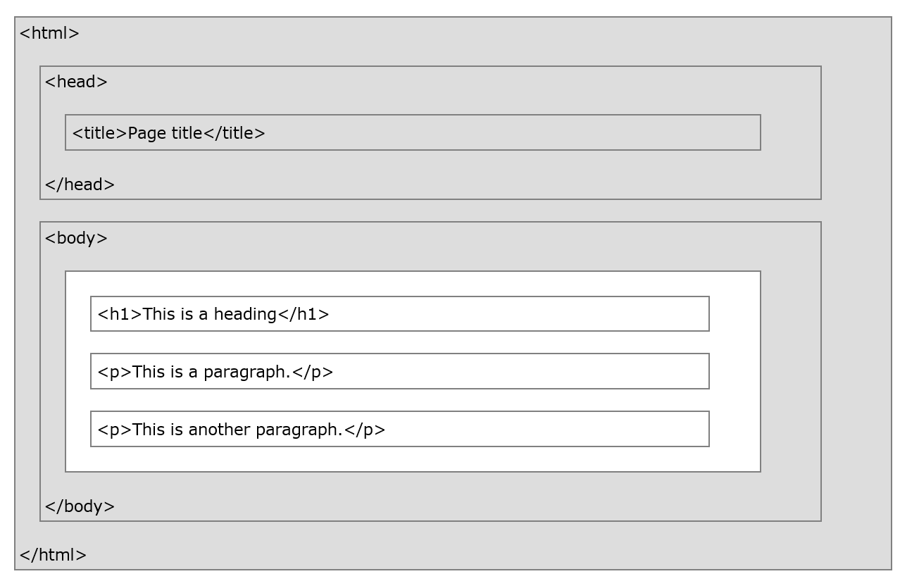

Slide 4
HTML Headings
HTML headings are defined with the <h1> to <h6> tags.
<h1> defines the most important heading. <h6> defines the least important heading
<h1>에서 <h6>으로 갈수록 글자 크기가 점점 작아짐

Slide 5
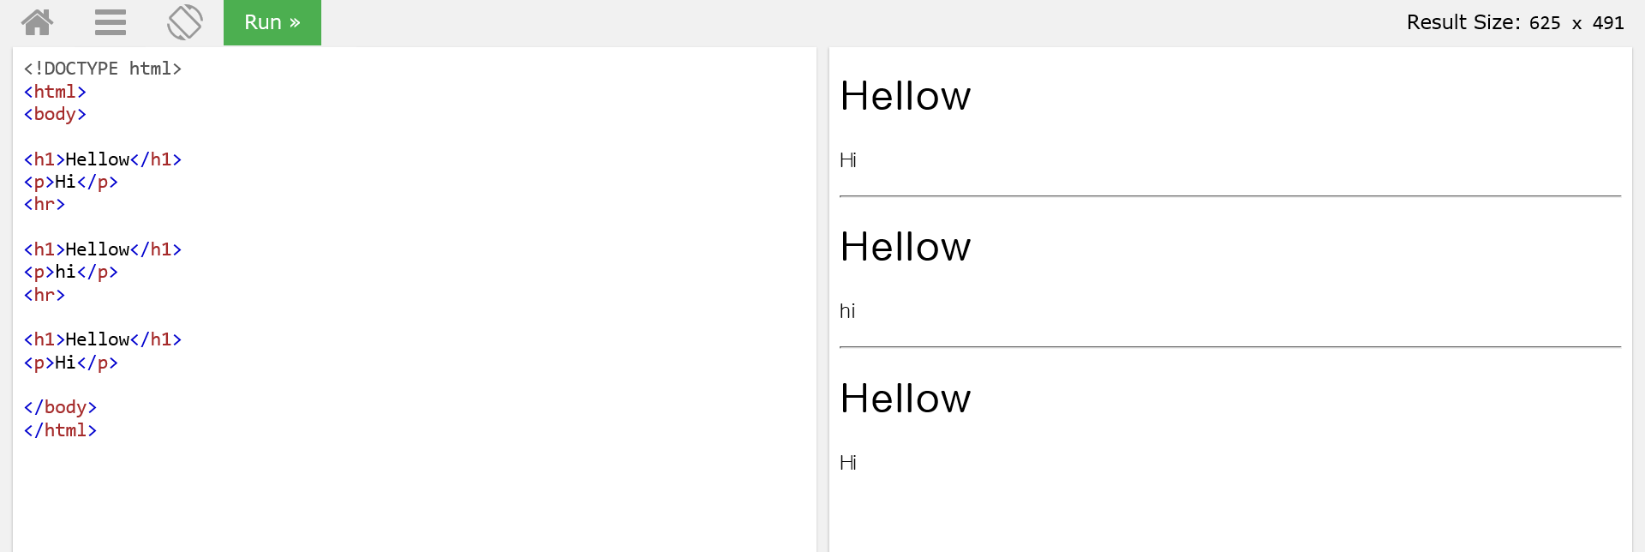
HTML Horizontal Rules
<hr>은 콘탠츠를 구분시켜준다.

Slide 6
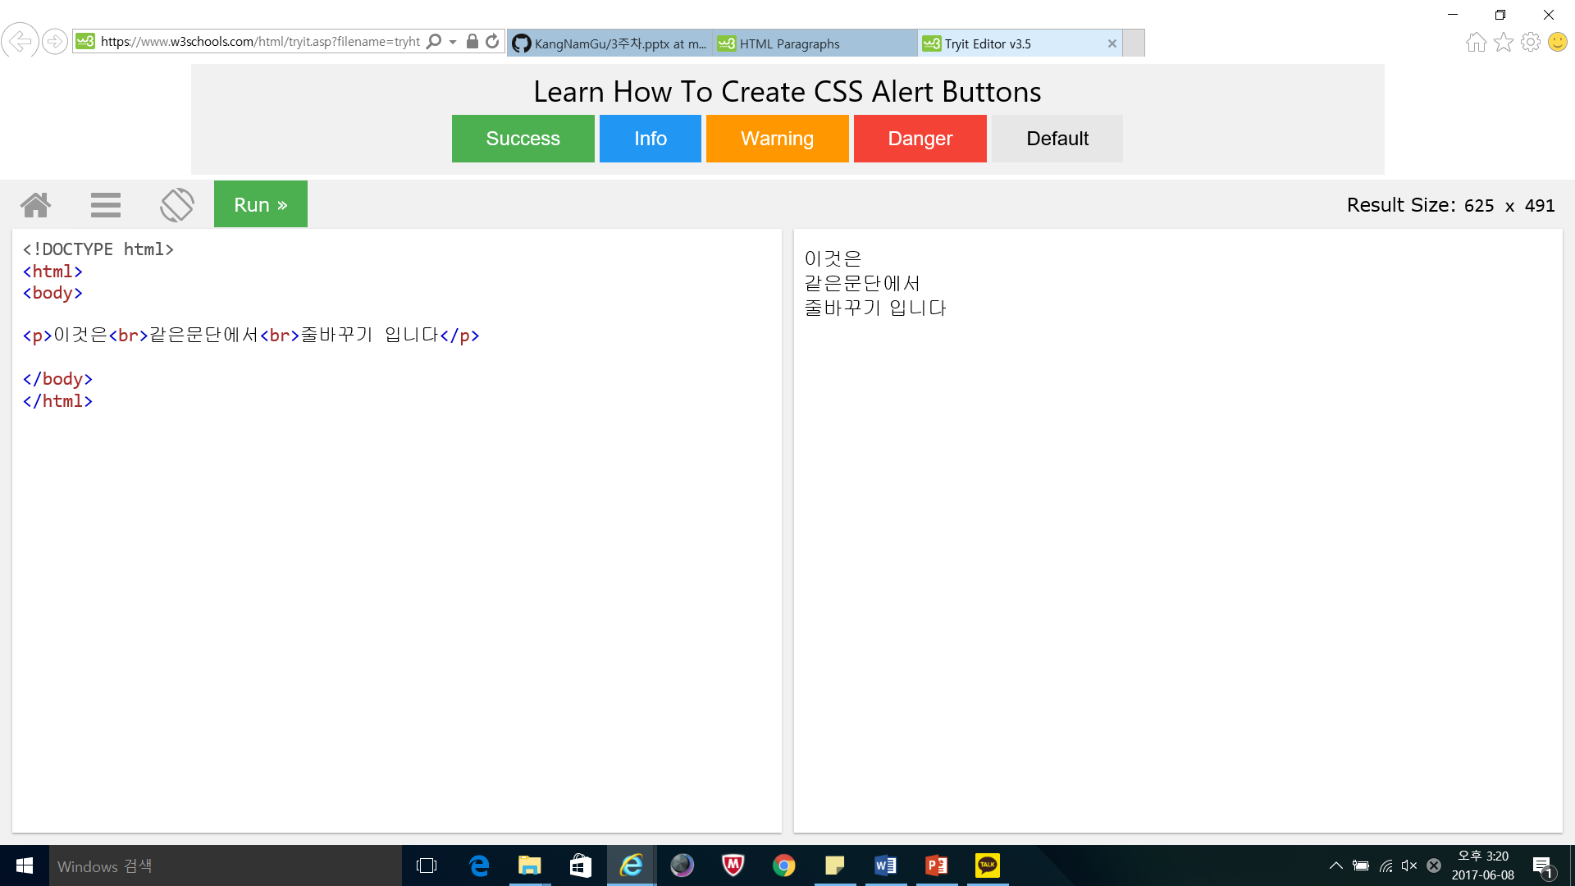
HTML Line Breaks

Slide 7
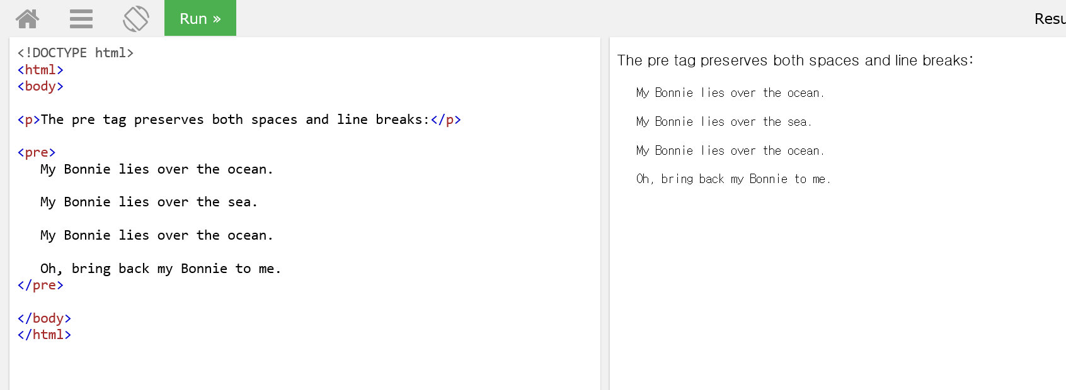
The HTML <pre> Element

Slide 8
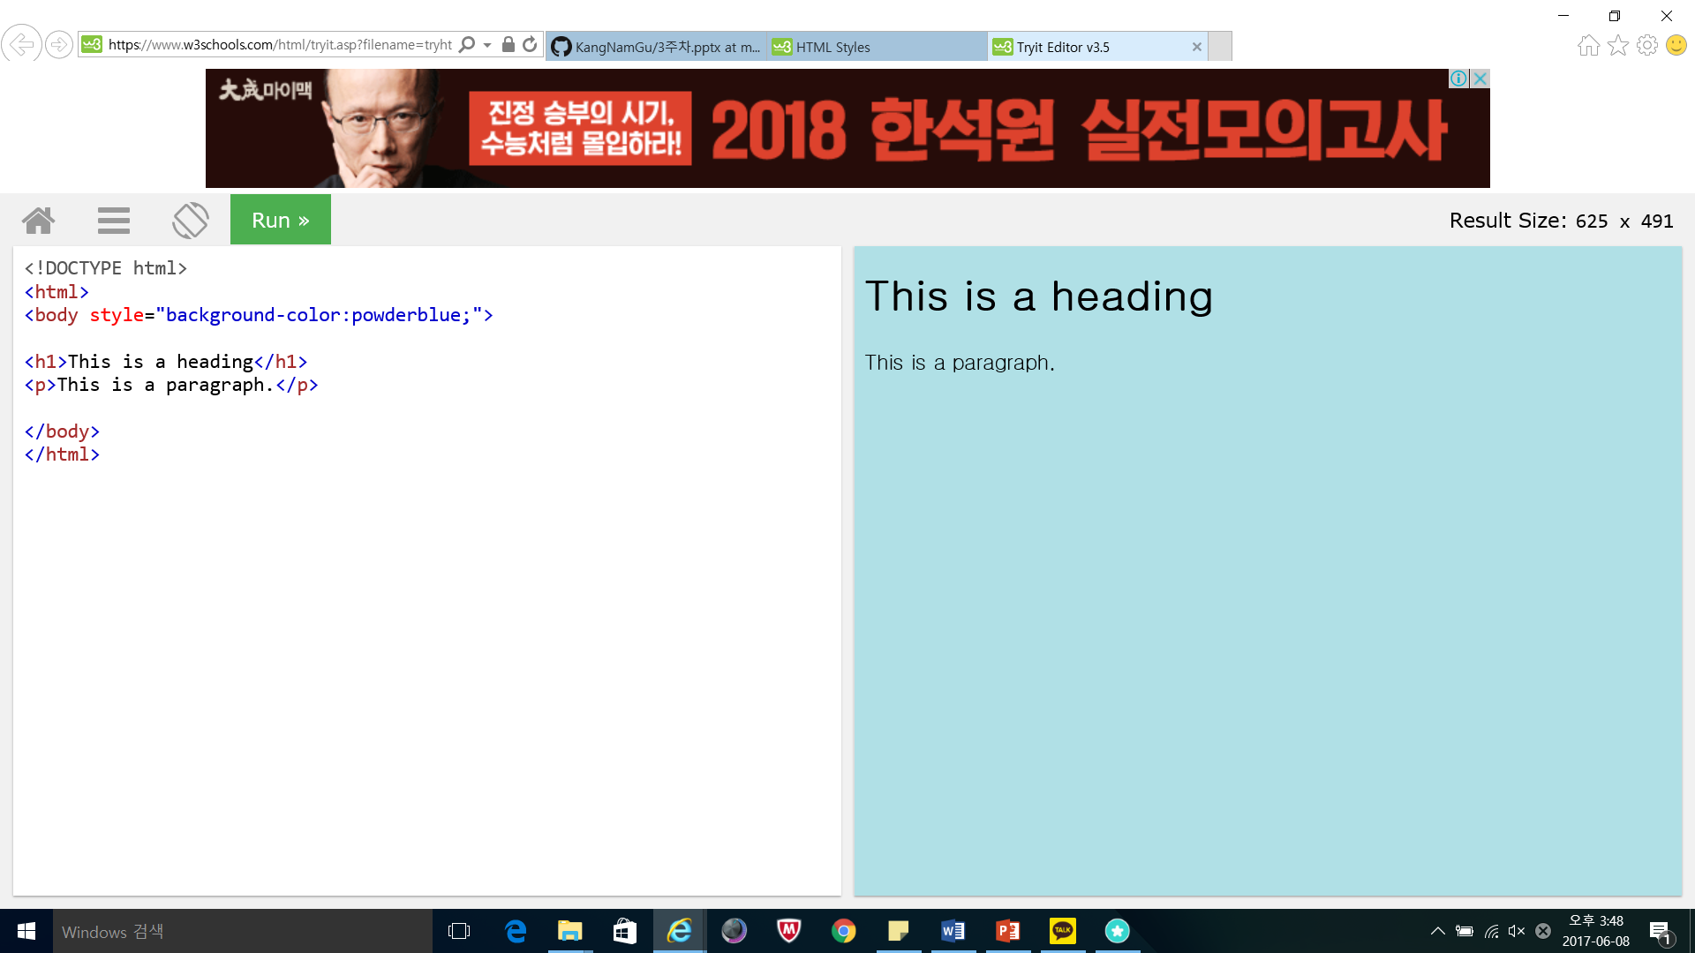
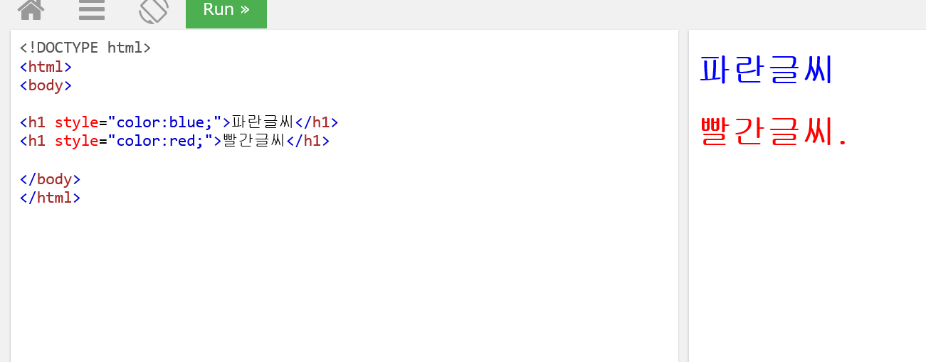
HTML Background, Text Color

Slide 9
HTML Formatting Elements
<b> - Bold text
<strong> - Important text
<i> - Italic text
<em> - Emphasized text
<mark> - Marked text(형광팬)
<small> - Small text
<del> - Deleted text
<ins> - Inserted text(밑줄)
<sub> - Subscript text
<sup> - Superscript text

Slide 10
Reference
W3schools.com

